Slide 1
Understanding RL Circuits: Theory and Numerical Analysis
Presented by: Tehreem Zahoor
Zoha Sheikh

Slide 2

CONTENT:
Introduction of RL Circuit
Behavior and characteristics
Transient Analysis
Steady-state Analysis
Numerical Analysis
Equation of RL circuit
Practical Applications

Slide 3

Introduction to RL Circuits:
  RL circuits combine resistors and inductors.
They display transient and steady-state behaviors.
RL circuits are vital in power electronics, control systems, and signal processing
. RL circuits demonstrate energy storage and release through resistance and inductance.
Understanding theoretical foundations, numerical analysis, and practical applications is crucial.
Designing and optimizing electrical systems rely on mastering RL circuit principles.
1

Slide 4
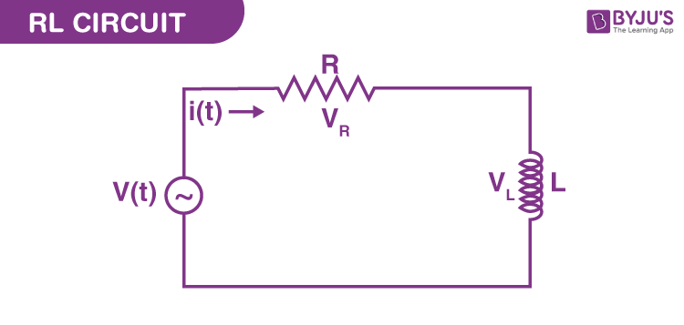

Slide 5
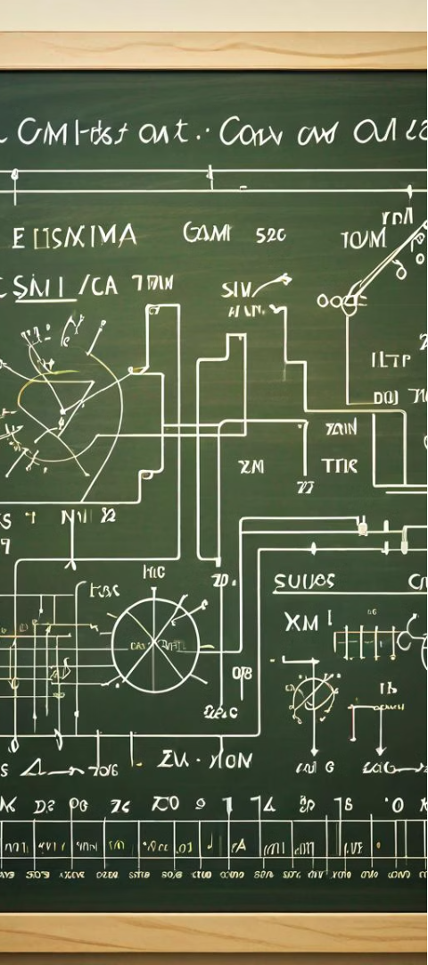

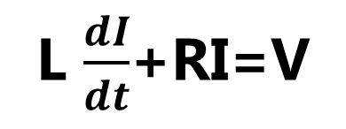
Theoretical Foundations:
1
Ohm's Law
The relationship between voltage, current, and resistance in electrical circuits is described by Ohm's law.
V=IR
2
Time Constants
RL circuits exhibit unique time constants that govern the rate of change in current and voltage during transient and steady-state conditions.
T=$\frac{L}{R}$
3
Differential Equations
The behavior of RL circuits can be describe by first-order linear differential equations derived from KVL and relationship between voltage, current, inductance.
L $\frac{dI}{dt}$+RI=V

Slide 6
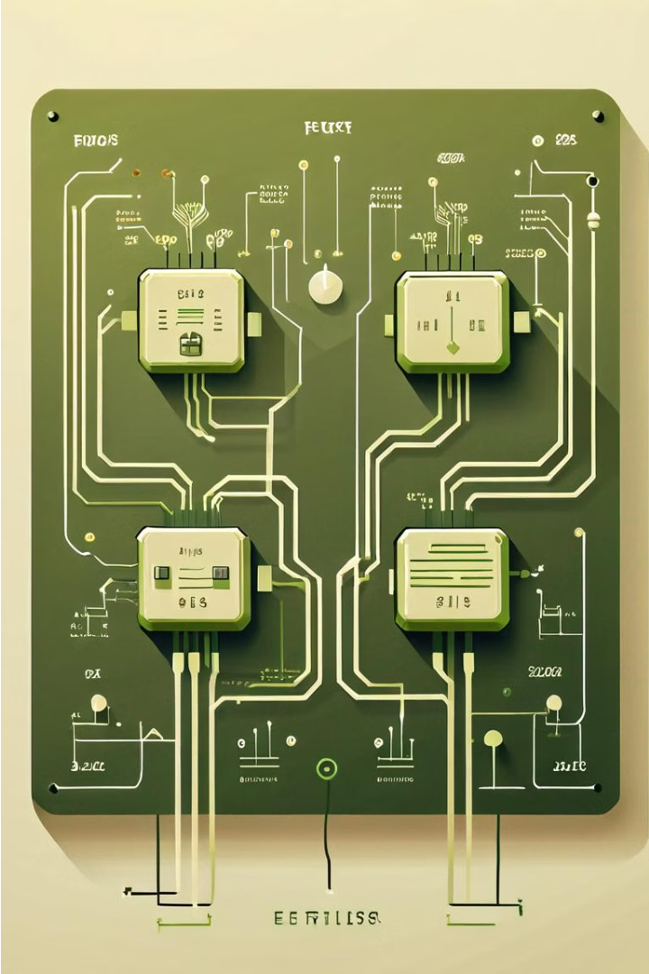
RL Circuit Behavior and Characteristics
Behavior :
Characteristics:
Inductor’s Role
Resistor’s Role
Time Delay
Energy Storage
Smooth Flow

Slide 7




Transient Analysis
Initial Conditions
Differential Equation
Solving the Equation
Identify the initial conditions of the RL circuit, such as the initial current in the inductor and the initial voltage across the capacitor.
Set up the differential equation that describes the behavior of the RL circuit during the transient state.
Use analytical methods or numerical techniques to solve the differential equation and find the time-domain expressions for current and voltage.

Slide 8
Steady-State Analysis
Resistance
1
Affects current flow.
Inductance
2
Opposes changes in current.
Steady State
3
Current and voltage are constant.
In the steady-state analysis of RL circuits, we focus on the long-term behavior when the circuit has reached a stable condition. The resistance and inductance of the circuit elements determine the steady-state current and voltage. This analysis provides insights into the circuit's behavior under continuous, unchanging conditions.

Slide 9
Numerical Analysis of RL Circuits
1
Differential Equation Modeling
2
Numerical Solution Methods
Represent the RL circuit's dynamic behavior using first-order linear differential equations to capture the interplay between resistance and inductance.
Apply numerical techniques such as the Euler method or the Runge-Kutta method to solve the differential equations and obtain the time-domain solutions for current and voltage.
3
Transient Response Analysis
4
Steady-State Behavior
Investigate the circuit's transient response, including the rise time, time constant, and the exponential approach to the steady-state values.
Analyze the steady-state characteristics of the RL circuit, such as the final current and voltage levels, power dissipation, and phase relationships.

Slide 10
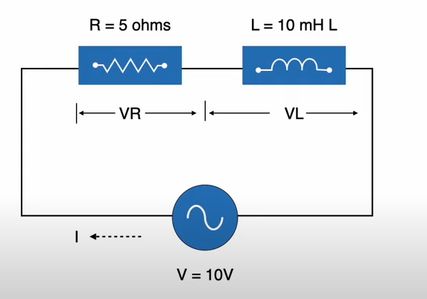
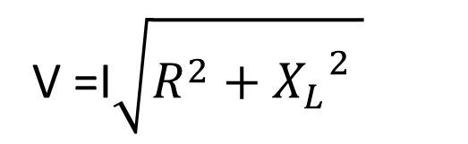
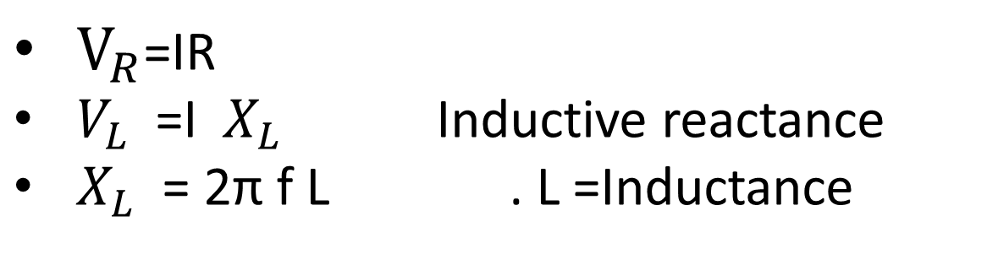
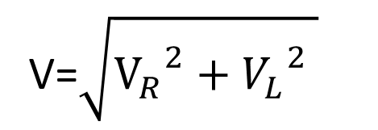


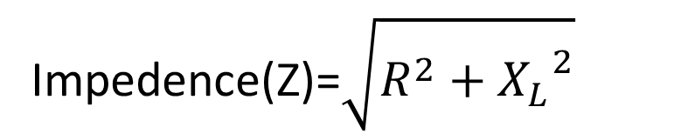
Phasor Diagram:
$$V_{L}$$
Equation of RL Circuit
V
I
$$V_{R}$$
V=$\sqrt{{V_{R}}^{2}+{V_{L}}^{2} }$
V =I$\sqrt{R^{2}+{X_{L}}^{2} }$
Impedence(Z)=$\sqrt{R^{2}+{X_{L}}^{2}}$
$V_{R}$=IR
$V_{L}$ =I${ X}_{L}$ Inductive reactance
$X_{L}$ = 2π f L . L =Inductance
Impedance appears as two different voltages that are signified with V_{R} and V_{L} based on the different phases of applied current within RL series circuits.
V=IZ

Slide 11
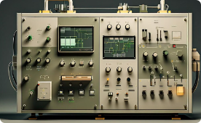


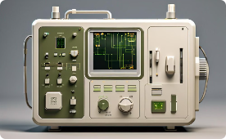
Practical Applications and Examples
Industrial Automation
Educational Applications
Home Electronics
Medical Applications
RL circuits are widely used in industrial automation systems to control and monitor the behavior of various electromechanical components, ensuring precise and efficient operation.
Like : Control system ,
Motor System
RL circuits are a fundamental topic in electrical engineering, allowing students to explore the principles of transient and steady-state analysis through hands-on experiments and simulations.
RL circuits are integral to the design of various home electronics, from audio amplifiers to power supplies, ensuring the smooth and efficient operation of these devices. Light Dimmers ,Appliance timers
RL circuits are employed in medical devices, like MRI and Implantable devices such as pacemakers and defibrillators, where their precise control and monitoring capabilities are essential for patient safety and treatment effectiveness.

Slide 12



Conclusion
Mastery
1
Deepening understanding of RL circuit principles
Application
2
Implementing RL circuits in real-world designs
Analysis
3
Leveraging numerical techniques for RL circuit optimization
In conclusion, the journey through RL circuit theory and numerical analysis has equipped us with a solid foundation to tackle increasingly complex electrical engineering challenges. By mastering the underlying principles, we can confidently apply RL circuits in a wide range of practical applications, from industrial automation to medical devices. The powerful numerical analysis tools we've explored will enable us to optimize RL circuit designs, pushing the boundaries of efficiency and performance.

